Slide 1
Python for Machine Learning
UE19EC353
Department of ECE

Slide 2
People
Instructors:
Prof Niranjana B Krupa
Prof Raghavendra MJ
Teaching Assistant: K Venkat Ramnan

Slide 3
Course Description
Unit 1 : Foundations of Machine learning
Unit 2 : Supervised Learning - Parametric methods
Unit 3: Supervised Learning - Non Parametric methods
Unit 4 : Kernel machines
Unit 5: Clustering and Dimensionality Reduction

Slide 4
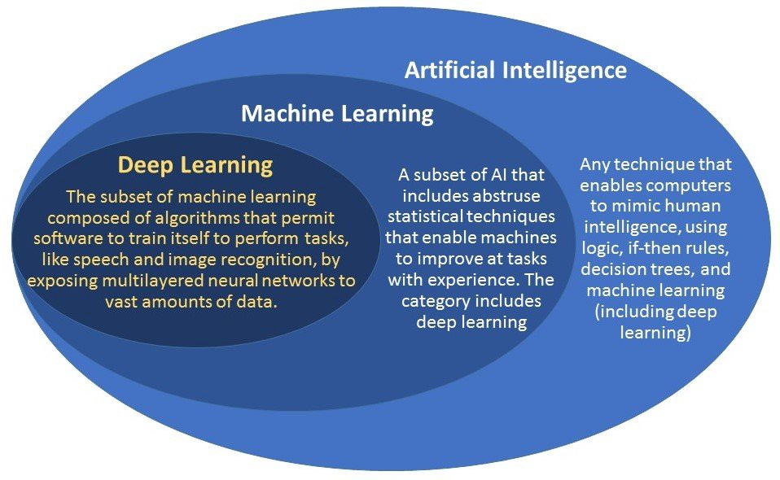
What is Machine Learning ?
Branch of AI
Data Analytics tool
category of an algorithm
use computational methods to “learn” information directly from data

Slide 5
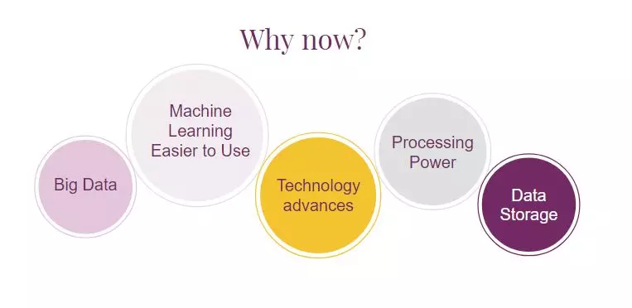
Why Machine Learning is booming?
The field has matured both in terms of identity and in terms of methods and tools.
abundance of data to learn from
abundance of computation to run methods

Slide 6
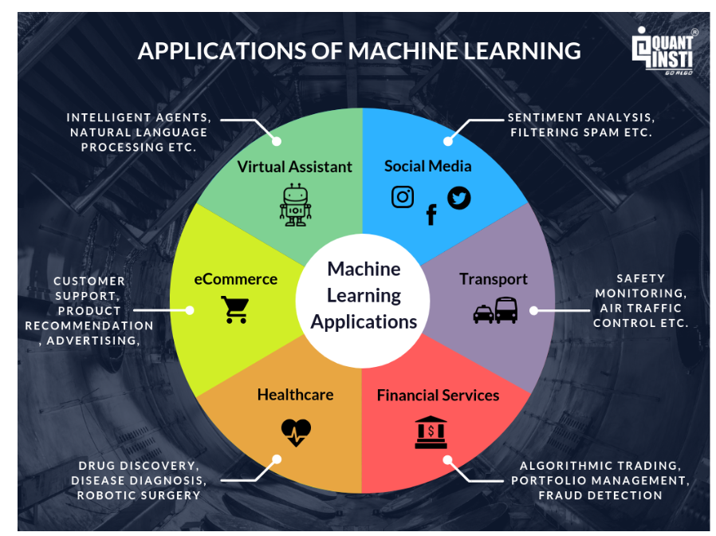
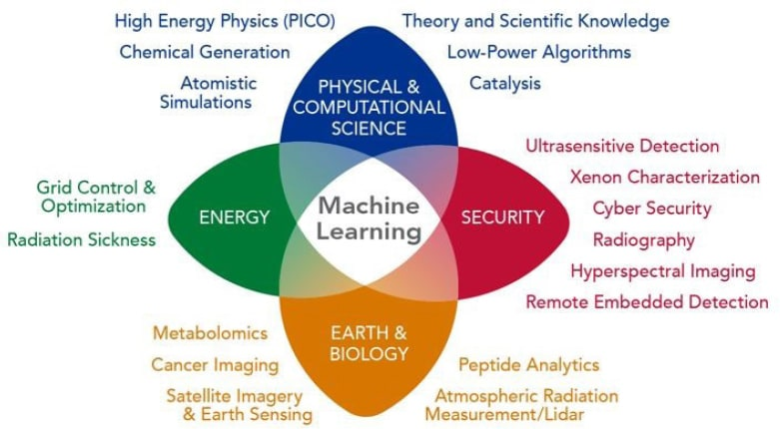
Where is Machine Learning used?

Slide 7
Setting up your PC for ML

Slide 8
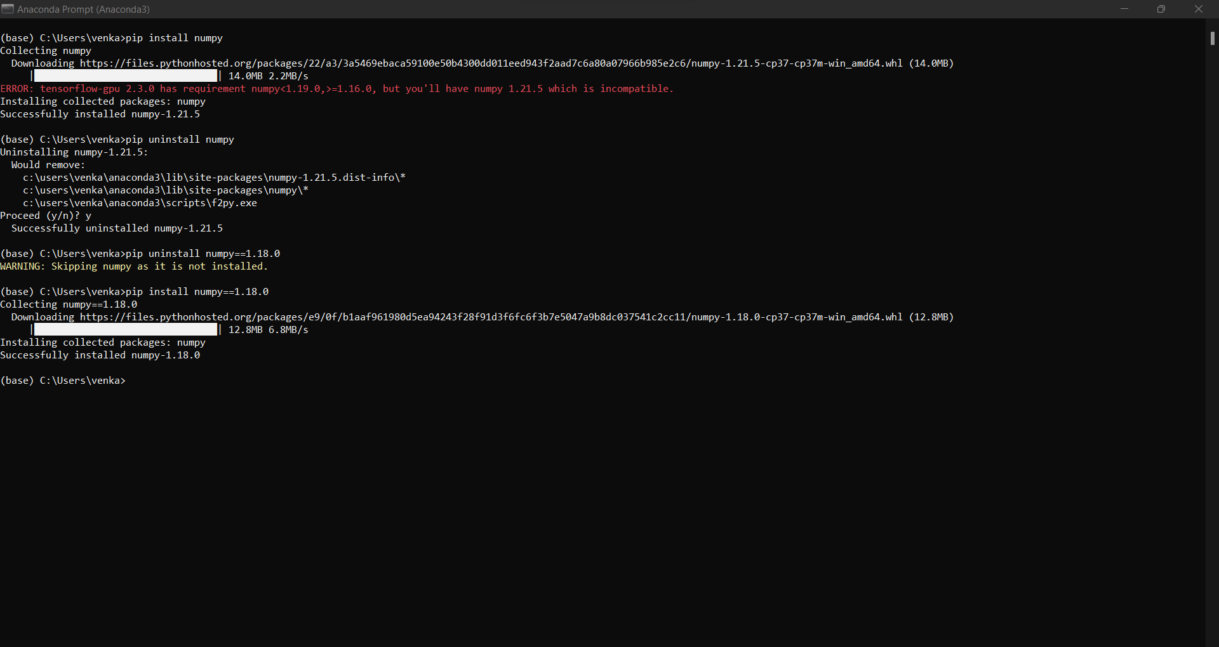
Installing packages using pip
Considering that you have installed python:

Slide 9
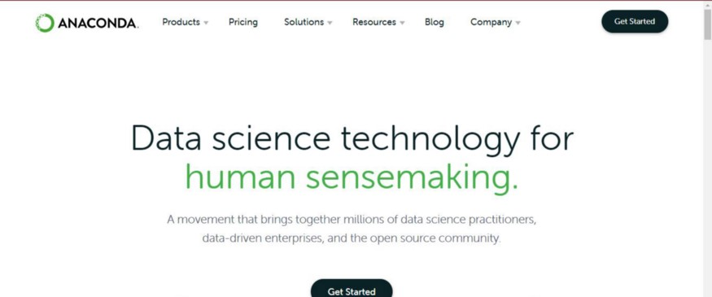
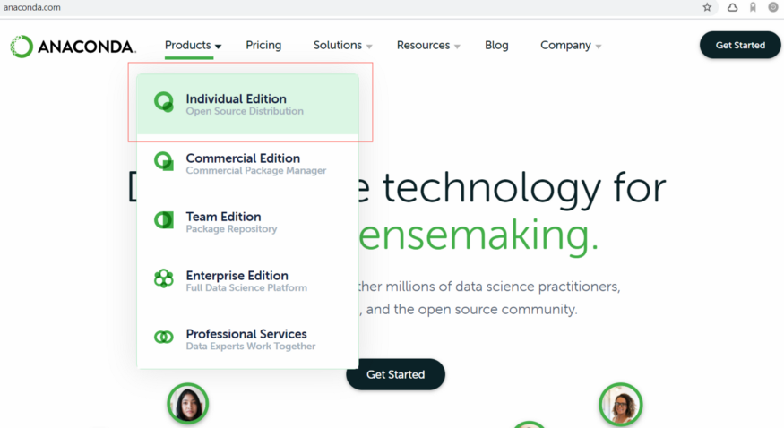
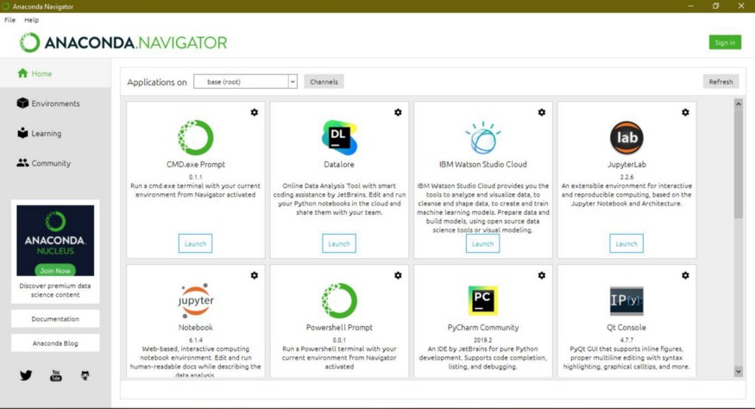
Anaconda Navigator

Slide 10
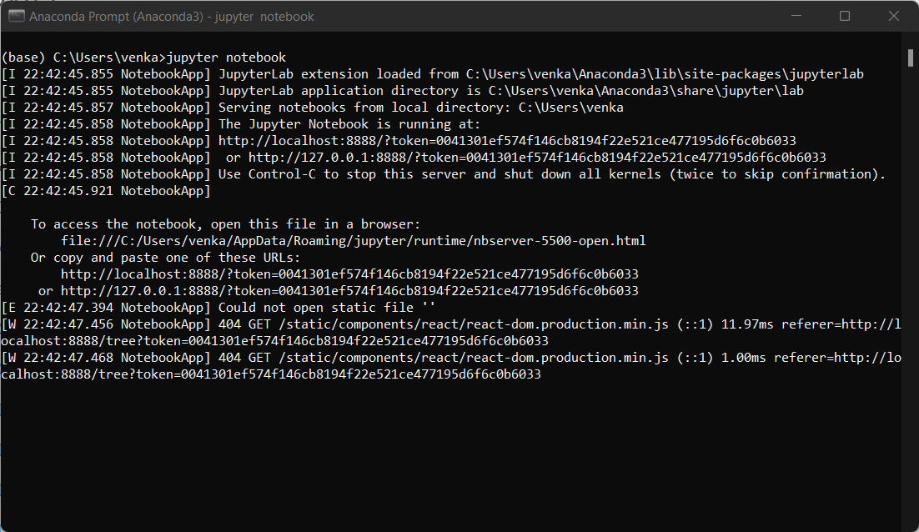
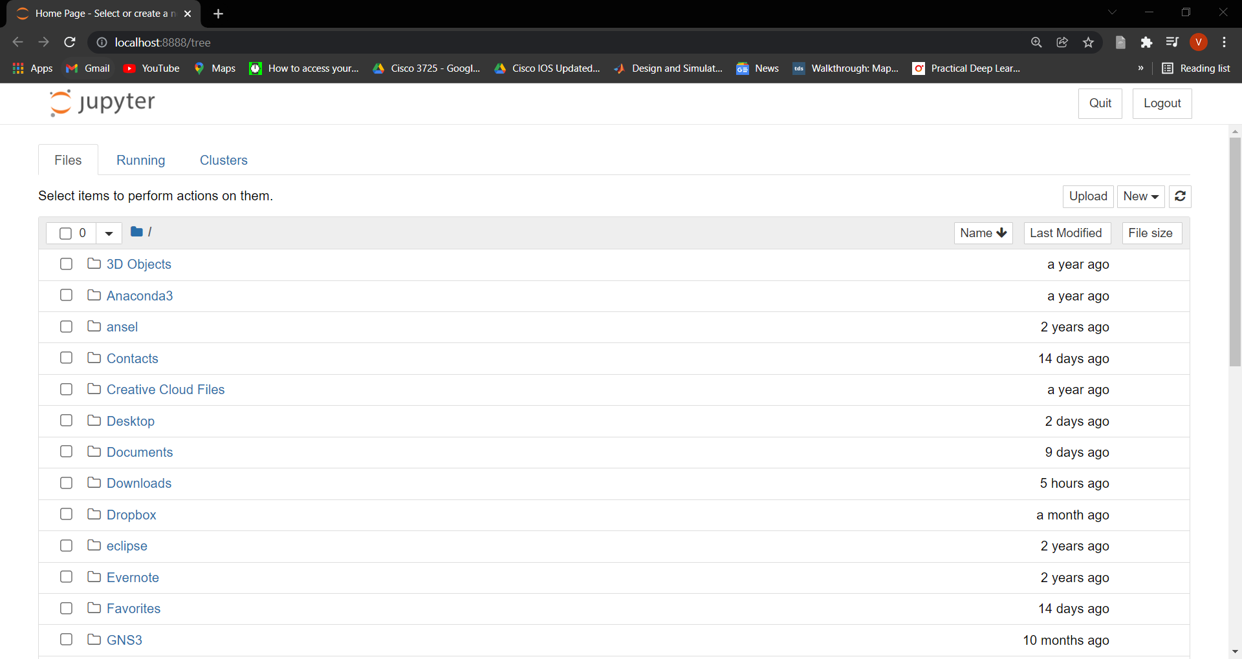
Jupyter notebook

Slide 11
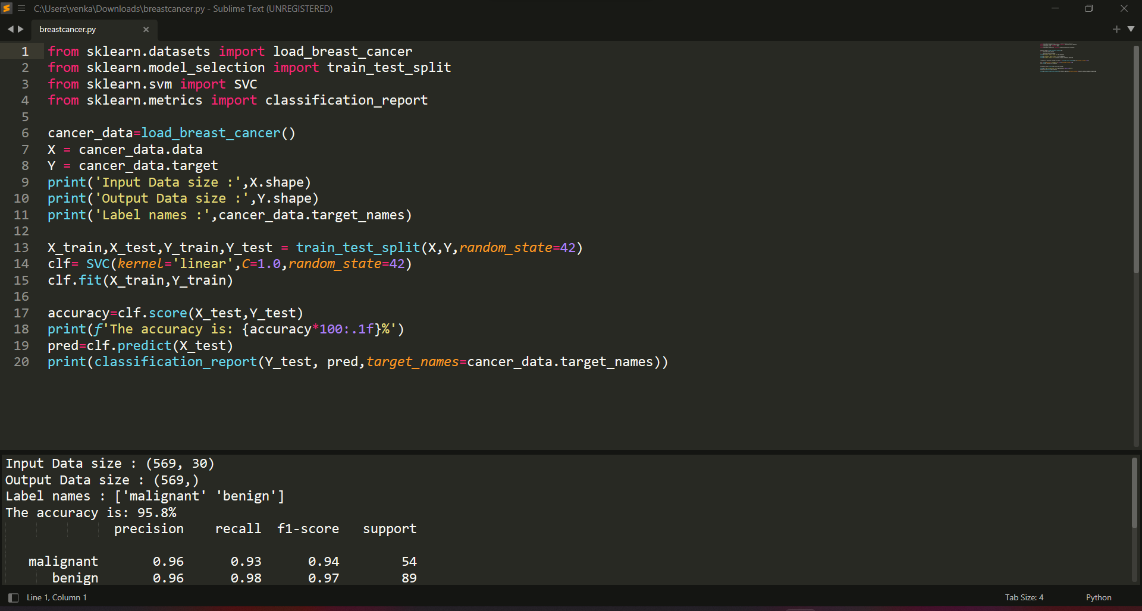
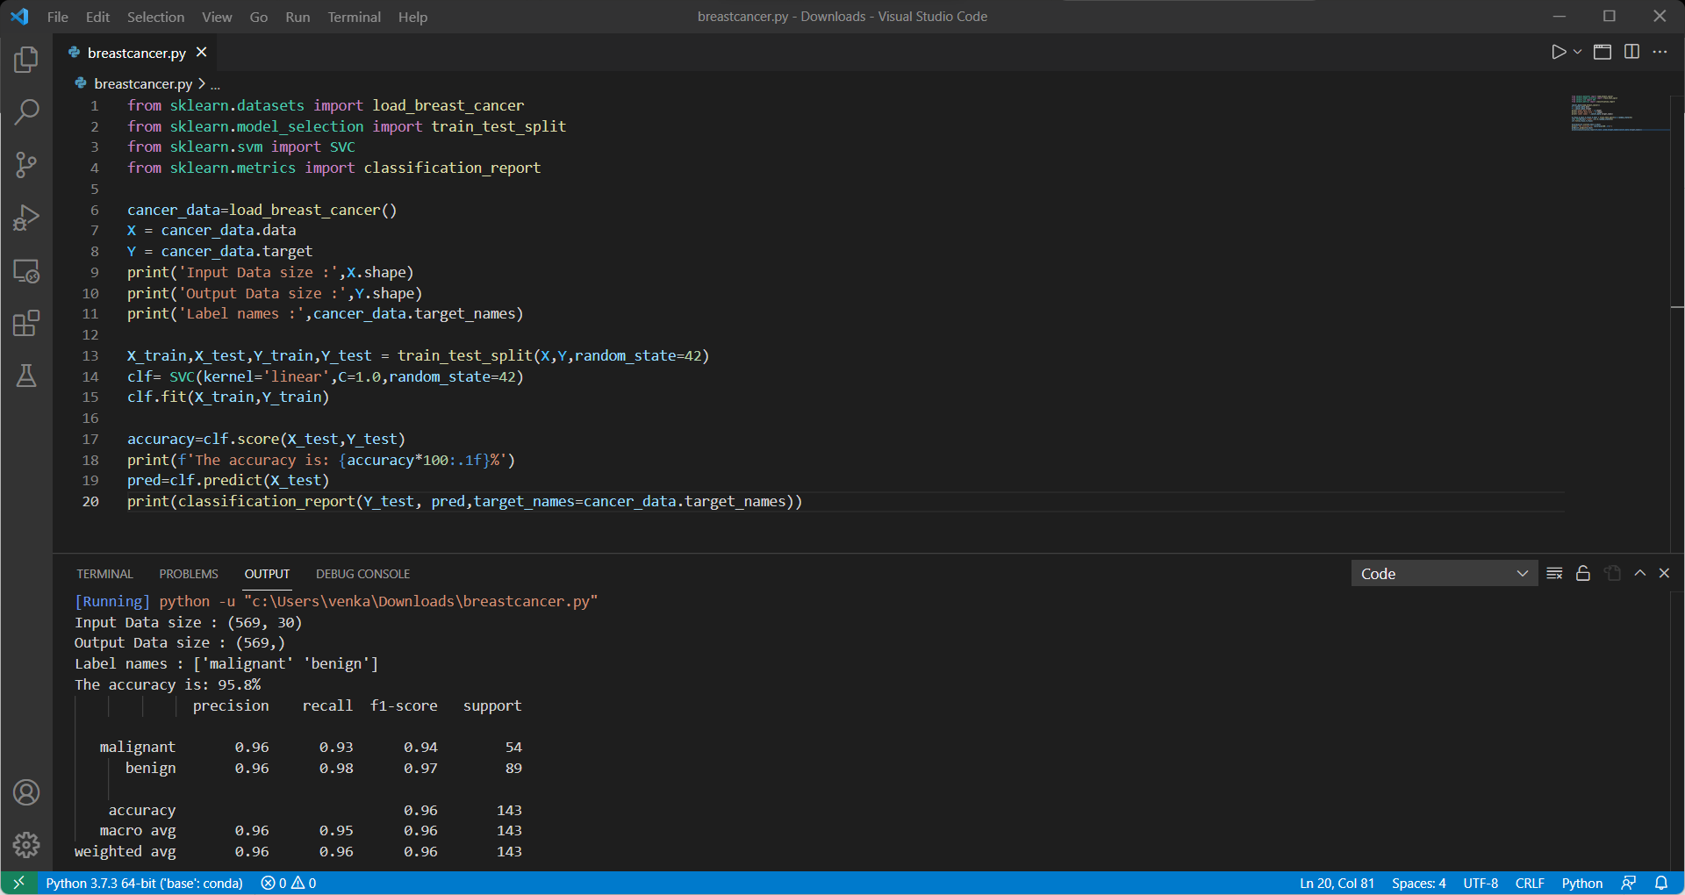
Other cool code editors

Slide 12
Hmm.. Out of RAM and GPU?

Slide 13
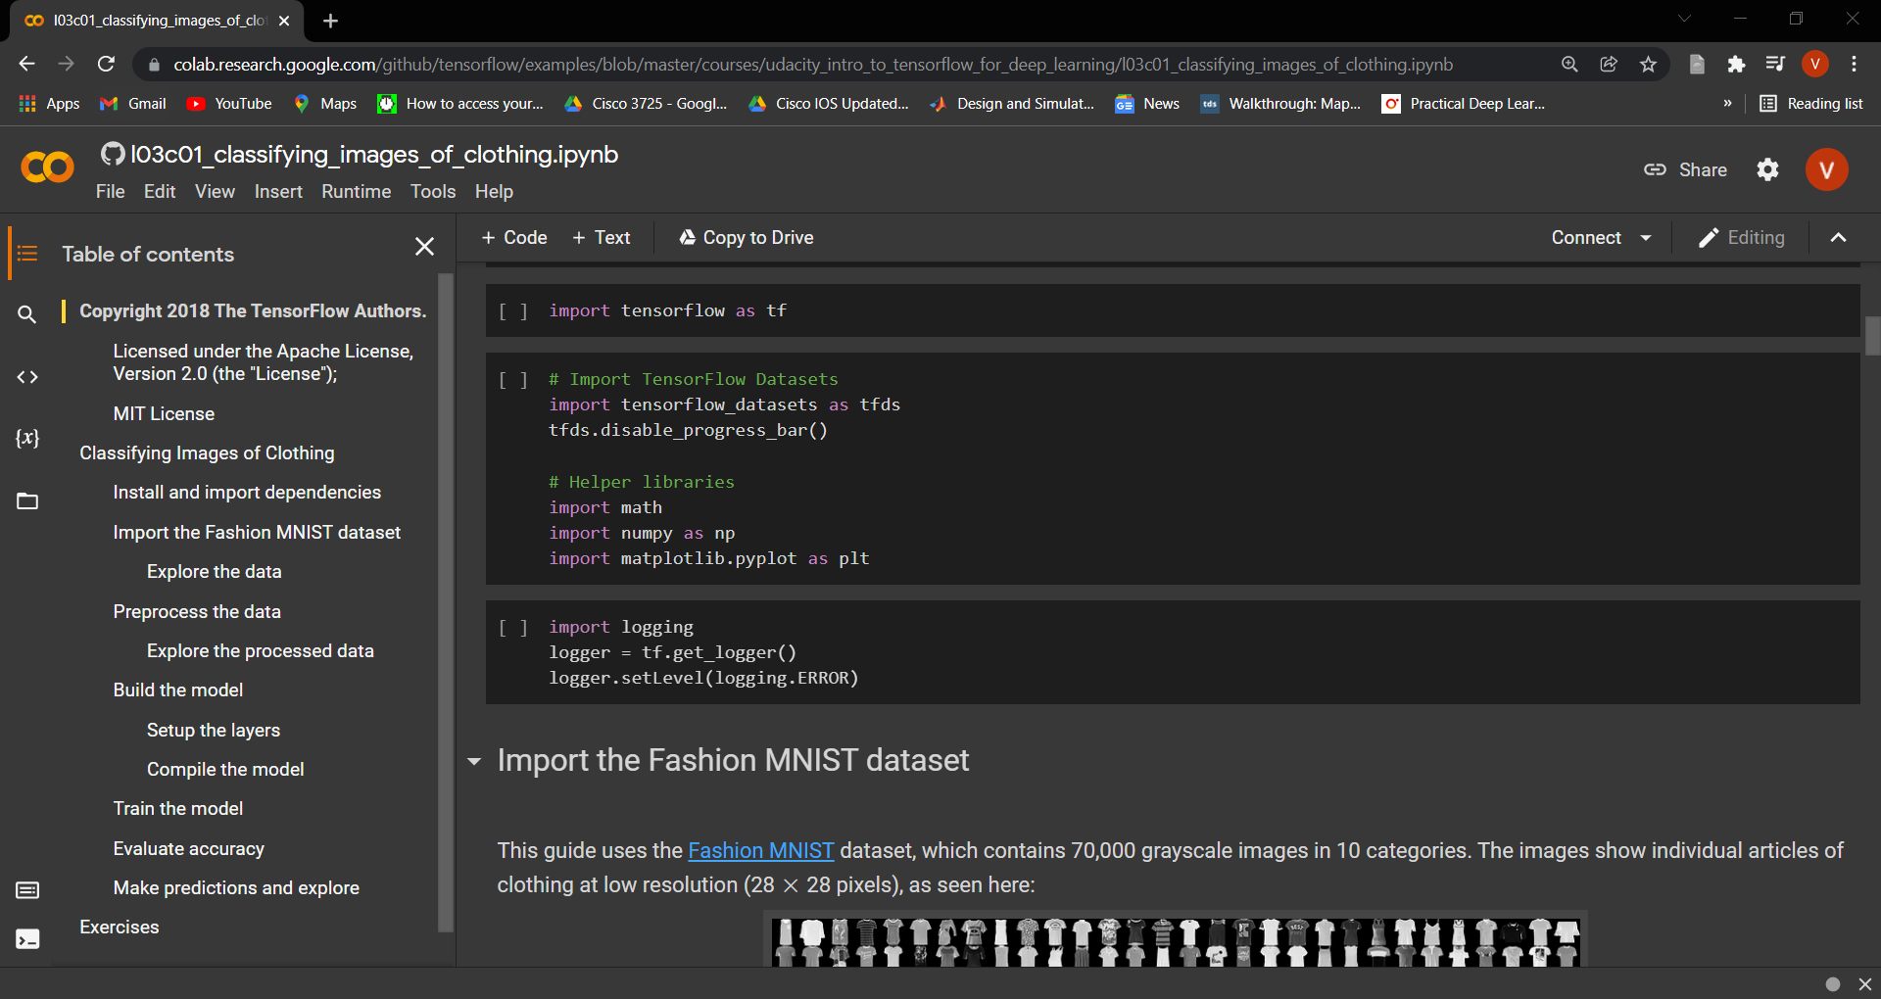
Google Colab is the answer!!

Slide 14
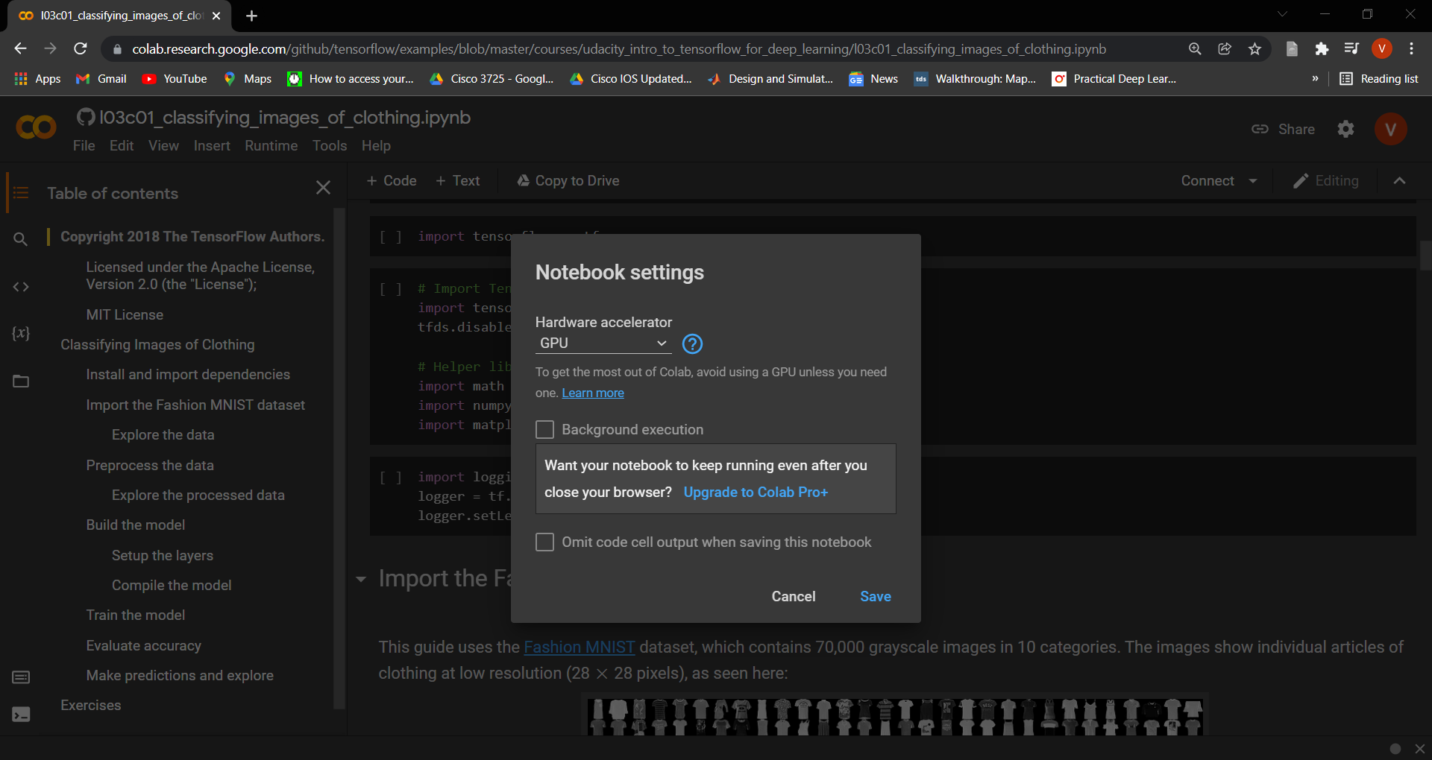

Slide 15
Research and Research!!!

Slide 16
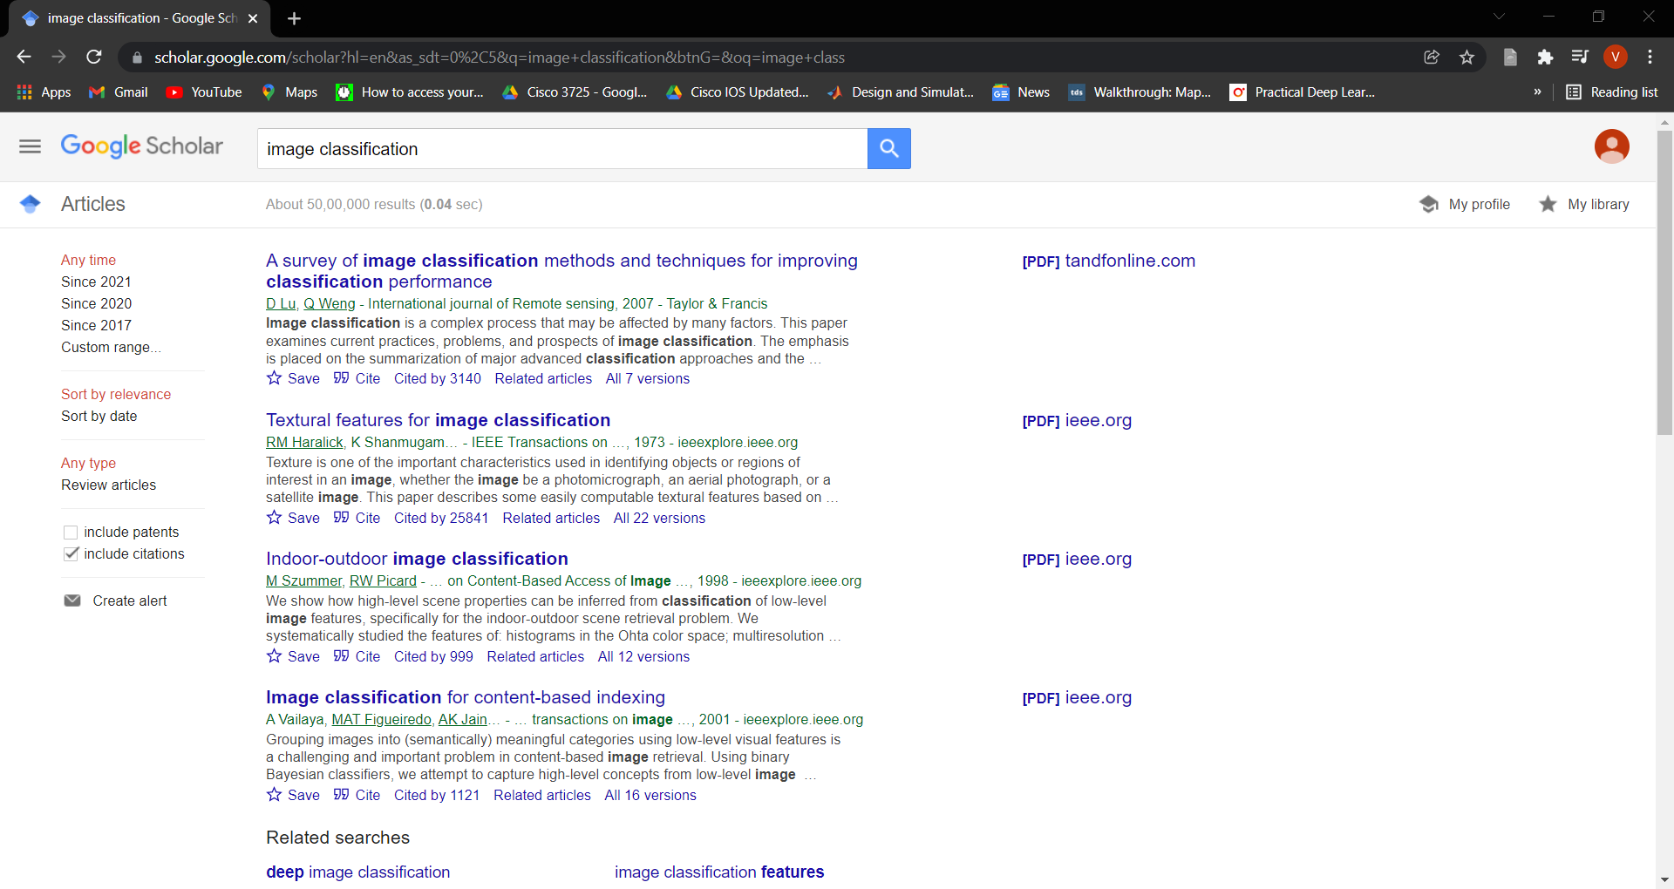

Slide 17



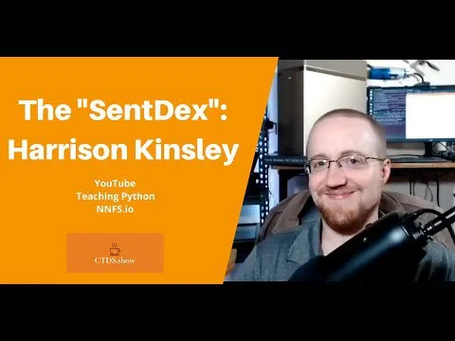
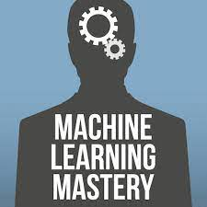


Some amazing resources on ML

Slide 18
Agenda
Day 1 : Introduction. Starting off with Numpy
Day 2 : Tabular Data with Pandas; Visualization with matplotlib
Day 3: Learning Scikit Learn; Into images with OpenCV
Day 4: Going Deep with TF

